Slide 1
Financial Analytics Data
By : Sakshi More

Slide 2
Introduction
In today's competitive business landscape, understanding market dynamics and competitor performance is crucial for strategic decision-making and sustained growth. This analysis focuses on exploring key financial metrics—market capitalization (Mar Cap) and quarterly sales (Sales Qtr)—of the top 500 companies in India. Market capitalization reflects the total market value of a company's outstanding shares, while quarterly sales provide a snapshot of revenue generation over a specific period.

Slide 3
Project objective:
To analyze the competitive landscape among the top 500 companies in India based on their market capitalization and quarterly sales data, and to derive meaningful insights that can guide strategic decision-making and enhance competitive advantage.

Slide 4
Details of Data
Name: This attribute serves as the identifier for each company in the dataset.
Mar Cap - Crore:Indicates the total market value of a company's outstanding shares. It reflects the market's perception of the company's value.
Sales Qtr - Crore:Represents the revenue generated by the company in a quarter. It reflects the company's operational performance and sales effectiveness.
Ratio - Crore:Calculated as Market Cap / Quarterly Sales. It indicates how efficiently the company is valued relative to its revenue generation.

Slide 5
Understanding the Financial Data

Slide 6
Financial Analytic
The analysis of competition among the top 500 companies in India involves examining two critical metrics: market capitalization (Mar Cap) and quarterly sales (Sales Qtr). Market capitalization provides a measure of the total market value of a company's outstanding shares, offering insights into its perceived value by the market. Key aspects include calculating average market capitalization across the dataset, assessing its distribution to identify outliers or clusters, and conducting a sector-wise breakdown to understand which sectors hold significant market value. On the other hand, quarterly sales represent the revenue generated by companies within a quarter, indicating their operational performance. Analyzing quarterly sales involves studying its distribution to gauge revenue scales across companies, calculating growth rates to identify high-performing entities, and comparing sales performance across sectors to discern industry leaders in revenue generation.

Slide 7
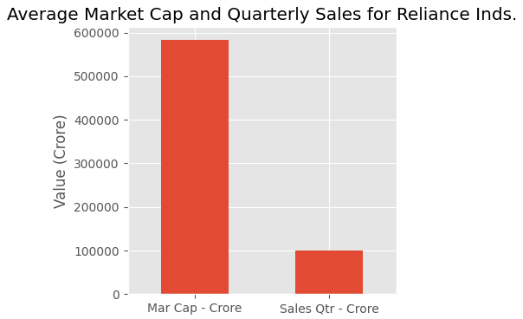
This analysis explores the relationship between market capitalization (Mar Cap) and quarterly sales (Sales Qtr) of India's top 500 companies. Key findings reveal a strong positive correlation between higher sales and increased market capitalization, highlighting the influence of revenue generation on market valuation. The analysis, supported by descriptive statistics and visualizations, provides actionable insights for strategic decision-making, emphasizing the importance of understanding financial metrics to navigate competitive landscapes effectively and drive sustainable growth.

Slide 8
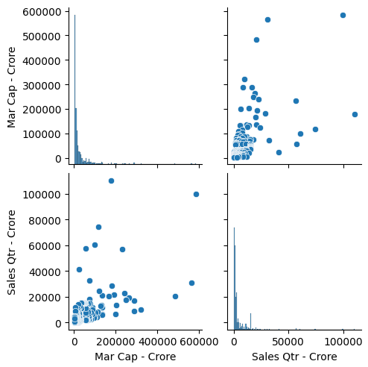
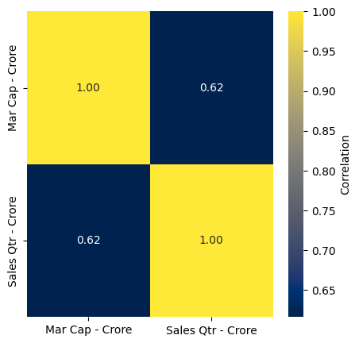
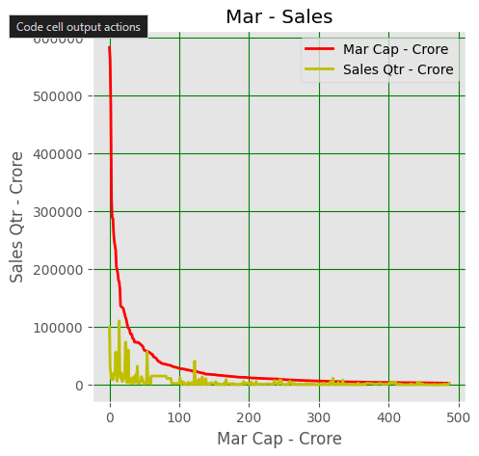
My Work:

Slide 9
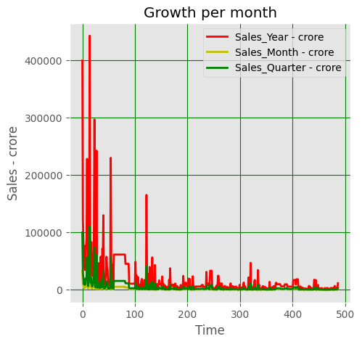
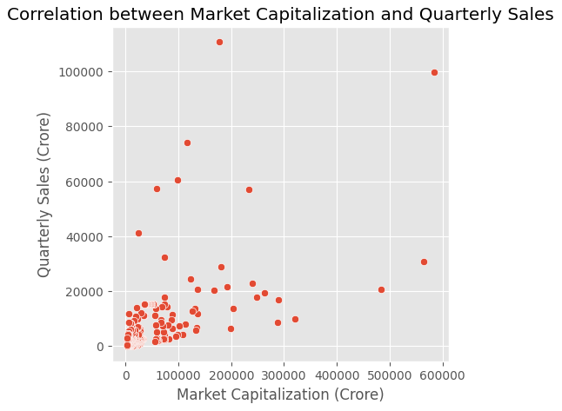

Slide 10
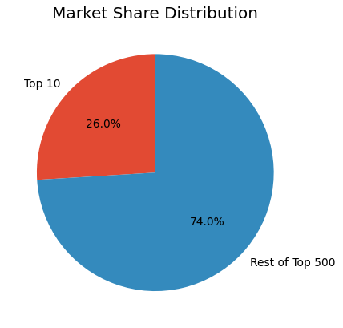
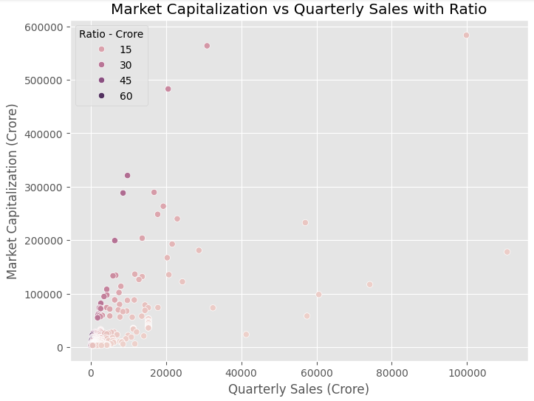

Slide 11
Thank You

